Slide 1
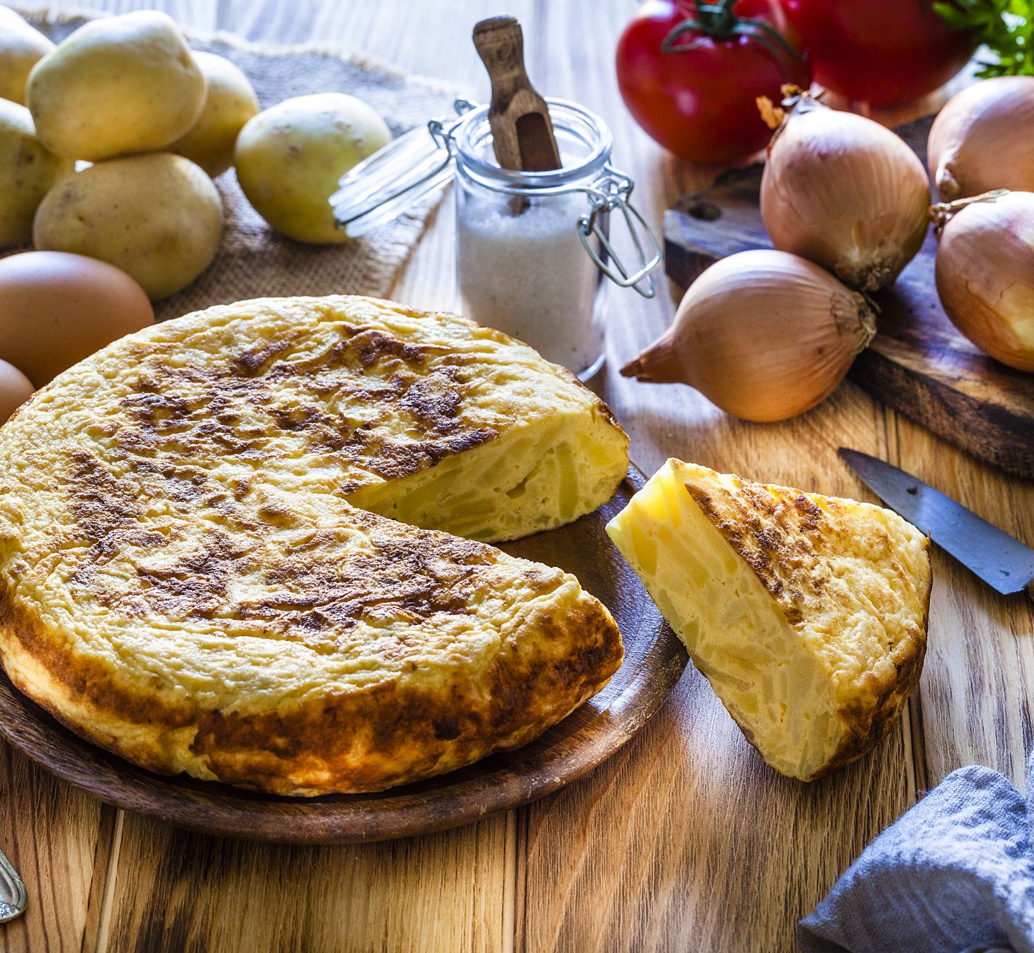
TasteHub
Discover, Create and Share your Favorite Recipes
Recipe Sharing Web application
Presented by: Jasmin Michael
Final Assignment: Full Stack Web Development

Slide 2

What is TasteHub?
TasteHub is a web application designed to bring recipes together in one easy-to-use platform.
👤 Create an account and log in
🍲 Create and share their own recipes
🔎 Search and browse recipes
📂 Organise recipes by category
❤️ Save favourite recipes
💬 Interact with recipes
🌐 Discover recipes using an external API

Slide 3
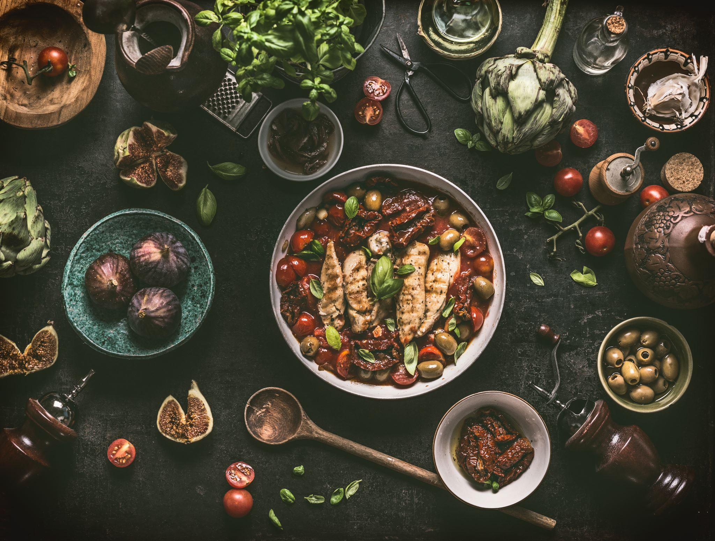
Who is TasteHub for?
TasteHub is aimed at people who enjoy cooking and want an easy way to discover and share recipes.Target users:
👩‍🍳 Home cooks
🥘 People looking for new recipe ideas
👨‍👩‍👧‍👦 Families planning meals
🌱 People interested in different types of food
📱 Users who want to access recipes easily online
Purpose
To provide a simple platform where users can discover, create and share recipes in one place.

Slide 4

Main Features
User Account Recipe Management
Registration Add recipes
Login / Logout View recipes
Personalised dashboard Edit recipes
Delete recipes
Recipe Discovery User Interaction
Search recipes Favourites
Filter by category Likes
External recipe API Comments (optional)

Slide 5
Technology Stack
TECHNOLOGY
Purpose
Django
Python
PostgreSQL
HTML5
CSS3
Bootstrap
JavaScript
External Recipe API
Git & GitHub
Render
Backend Web Development
Programming Language
Database Management
Web Page Structure
Web Page Styling
Responsive Design
Interactive Functionality
External Data Integration
Version Control
Application Deployment

Slide 6
Database & API Integration
Database
External Recipe API
PostgreSQL
Store user accounts
Store recipes
Store recipe categories
Store favourites and interactions
Django ORM for database operations
Connect TasteHub to an external recipe API
Search for recipes
Retrieve recipe information
Display external recipes within the application
Provide links to the original recipe where available

Slide 7
Project Goals
Build a fully functional recipe-sharing web application
Create a simple and user-friendly interface
Allow users to create and manage their own recipes
Provide recipe search and discovery
Integrate an external recipe API
Use secure authentication and authorization
Develop a responsive application for different devices
Test the application using automated unit tests
Deploy the completed application using Render

Slide 8
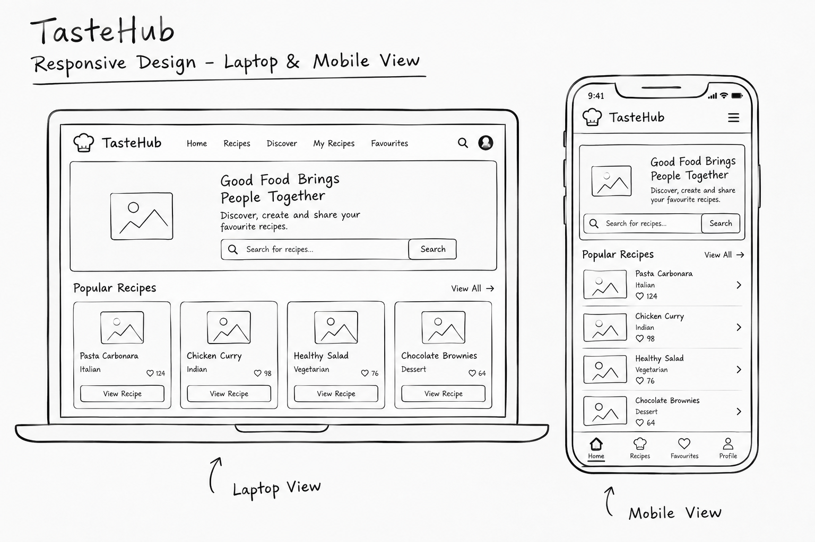

Slide 9
Development & Deployment
Development
Deployment
Django & Python
PostgreSQL database
Bootstrap responsive design
JavaScript
External Recipe API
Automated testing
Git & GitHub
Regular commits and feature branches
Deploy application using Render
Connect application to PostgreSQL database
Configure environment variables
Run database migrations
Configure static files
Test application in production
Provide deployed URL in README

Slide 10
Conclusion
TasteHub will provide a simple platform for sharing and discovering recipes.
Users will be able to create, manage and explore recipes.
The application will demonstrate full-stack web development skills.
An external recipe API will enhance recipe discovery.
The application will be responsive, tested and deployed on Render.
The project will be developed using Django, PostgreSQL, Bootstrap JavaScript.

Slide 11

THANK YOU
Jasmin Michael

